Slide 1
JAVA APPLICATION DEVELOPMENT - SCHEDULING APPOINTMENT
By Rifatul Karim (ID: 001515900)

Slide 2
About the project:
A scheduling application is one of many important business tool that allows users to book, reschedule, and cancel appointments through user interfaces.
Other than ability to view appointments in user interface, the major power of this tool is that the user also does not need to contact business managers to schedule or reschedule appointments or can make last-minute cancellation and such convenience overall saves the user and business time and money.
Additionally, a scheduling application can be more than just working with appointments as it can be further extended to view customer and contact data as well which the business managers can quickly work around with and edit any necessary changes as the application streamlines these processes.
Overall this project tries to emulate this useful business application and consist of several parts.

Slide 3
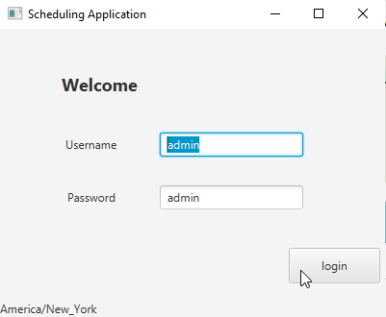
Login Screen - Main
Before viewing the appointment, for security purposes the user must login using the correct username and password. If the user inputs either one of the fields incorrect, the custom message will be displayed accordingly.
The user’s current ZoneId also display at the bottom-left.

Slide 4
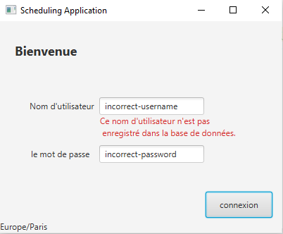
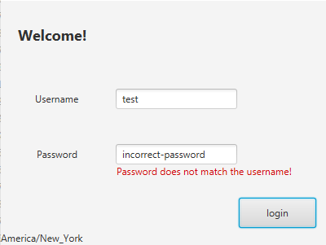
Login Screen – Error Message
Moreover, the application supports additional language, French, and this also means that the error messages also being displayed in the particular supported language as well.

Slide 5
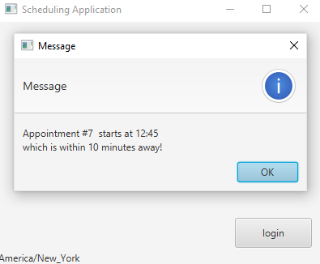
Login Screen – Upcoming Appointment
If there is any upcoming appointment schedule then the user is ensured to be alerted that right after the successful login which displays the appointment Id and the start time information as well.

Slide 6
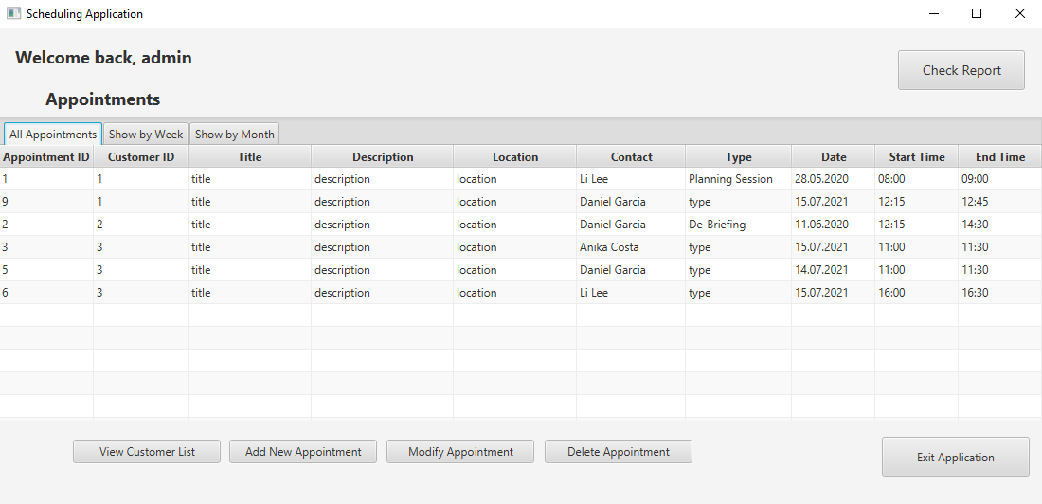
Main Screen – List of all appointments
The main screen of the application features list of all appointments table and appointments by week and month. The table displays the appointment start and end time according to the user’s local time. The list of customers can be view within by clicking the “view customer list” button and the special report can be access from the “Check Report” button. The data can be view by order by clicking the table column.
Other major part of the main screen is that each appointment can be modify, delete or can add a new appointment by selecting one from the table and then click on the respective button and.

Slide 7
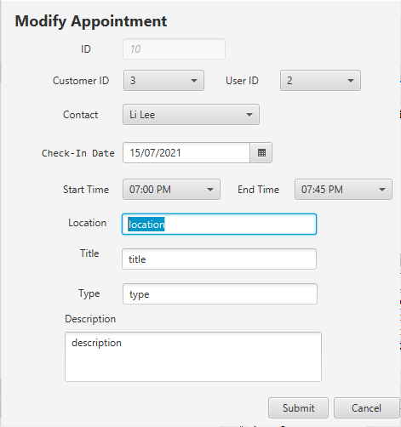
Appointment Edit Screen – Modify Appointment
As user select the particular appointment to modify, the program initializes textfield and combo box are field with the data accordingly registered with the appointment Id from the database. From here, the user can edit the data except for the Id which remain disabled. The start and end time are displayed in 12 hour format for further convenience.

Slide 8
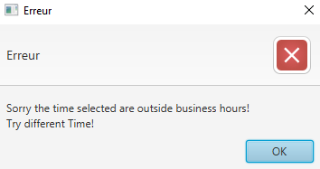
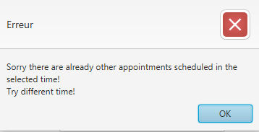
Appointment Edit Screen – Add Appointment
Once the user choose to add new appointment, the appointment edit screen displays with empty field which the user must filled. The Id field remain disabled and does not show new Id data yet. The end time field also disabled until the user picks a start time.
As the user fills the data and clicks the save button in regardless of modifying or adding new appointment, the program will display custom error message depends if there are selected appointment start time and end time overlaps or they are outside business hours which is calculated by converting the times in EST format and check against if they are after 8:00am or ends before 10:00pm. Once the user can save successfully, the main table will update and reflect new changes whether the user add new, modify existed or delete appointment.

Slide 9
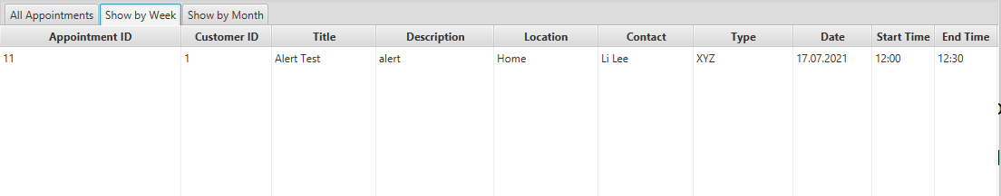
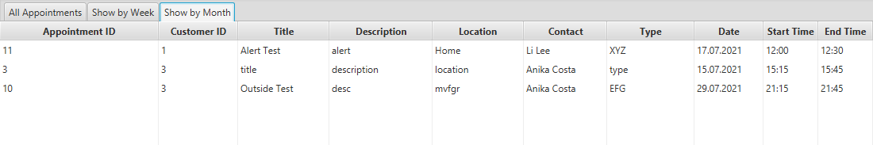
Main Screen – View By Week and View By Month The user can view the appointments by week and month by clicking the respective tab. These data are displayed using tree table view feature.
View By Week
View By Month

Slide 10
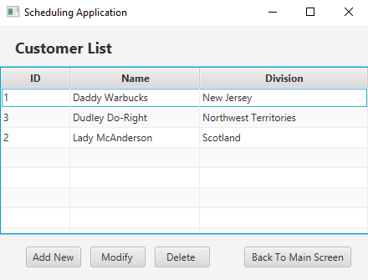
Customer Screen – List of All Customers
The customer screen displays list of customers which only includes their Id, Name and their Division. Similar to the main screen, the existing customer data can be modify and delete or add new customer by clicking on the respective buttons.

Slide 11
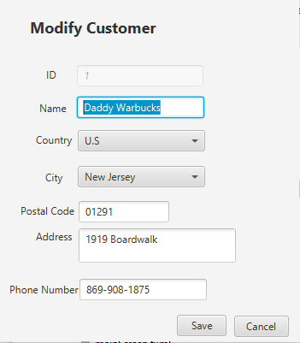
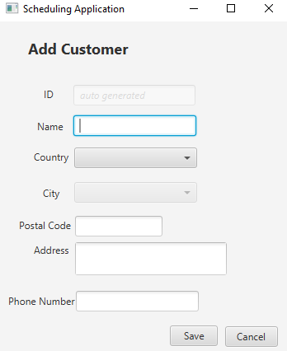
Customer Edit Screen – Modify Customer or Add New Customer
On the modify screen, the program will load customer edit screen with data according to the customer Id that is selected from the table of the customer screen. All of the data can be change except for the Id which is read-only mode. The city combo box remains disable until the user picks a country and as the user picks different country, the city list also changes according to the country Id.
As the user fills the fields, the program displays error message if there are empty on the fields otherwise the customer table gets update with new change or addition and as well the user can add or modify appointment with the new customer data on the main screen.

Slide 12
Report Screen
The report screen can be accessed from the main screen of the application by clicking the “Check Report” button. The report screen displays statistical information or and shows the hidden part of the data that are not shown in the tables and are directly accessed from the database using specific query instruction.

Slide 13
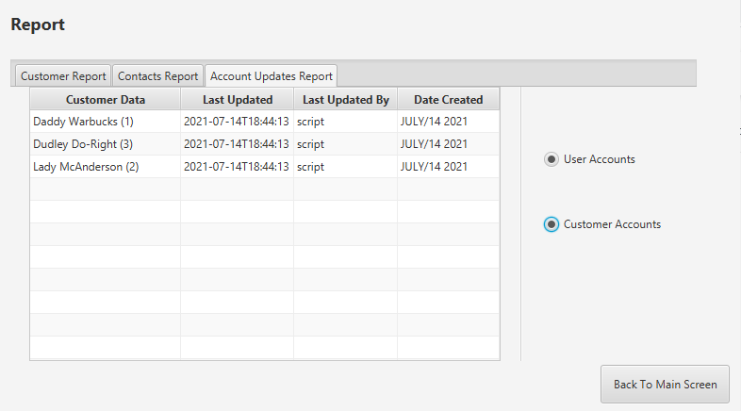
Report Screen – Account Update Report
The account update report displays both all of user and customer account creation date and who and when last time they were updated.

Slide 14
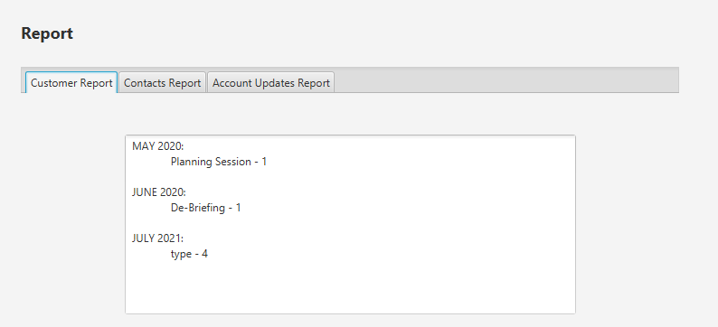
Report Screen – Customer Report
This part of report displays the total number of customer appointments by type and month in a text area that cannot be edit.

Slide 15
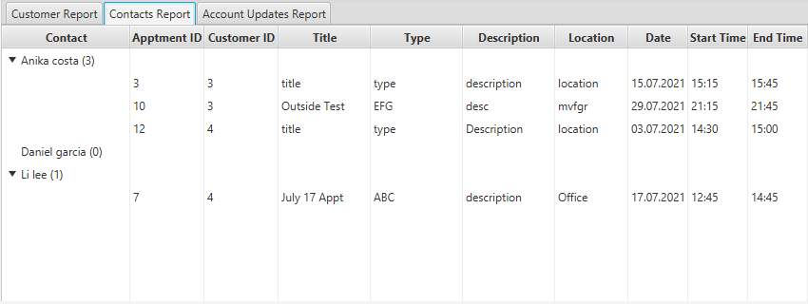
Report Screen – Contact Details
This part of the report shows the schedule for each contact in the organization.

Slide 16
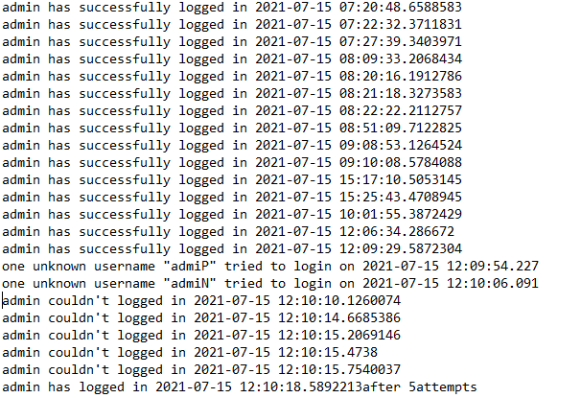
Other feature - Logging
Other feature of the application is that the program tracks user activity by recording all user log-in attempts, dates, and time stamps and whether each attempt was successful in a file named login_activity.txt.
Small security feature detail added as the custom message displays if the unknown username, i.e. the username that was not found in the database, tries to login or number of consecutive attempts the user took to login at the same time which could implies if other unknown user uses brute force to login.

